Slide 1
Flow-Based Networking Energy model
For shared equipment: Flow-based model
For equipment in end user premises (which are not shared): Time-based model
cloud
Shared devices(Application perspective)
Proxy
server
router
End user devices (Time based model, Device perspective)
Smart camera
Smart camera
Smart camera
Smart camera
Jalali, Fatemeh, et al. "Fog computing may help to save energy in cloud computing." IEEE Journal on Selected Areas in Communications 34.5 (2016): 1728-1739.

Slide 2
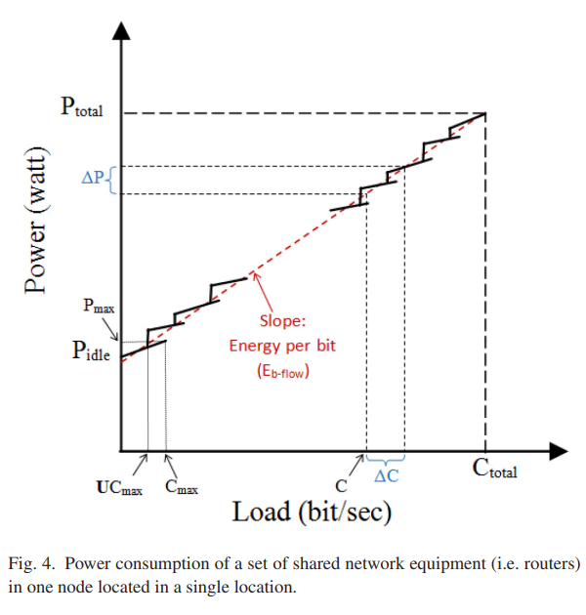
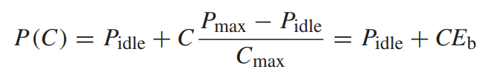
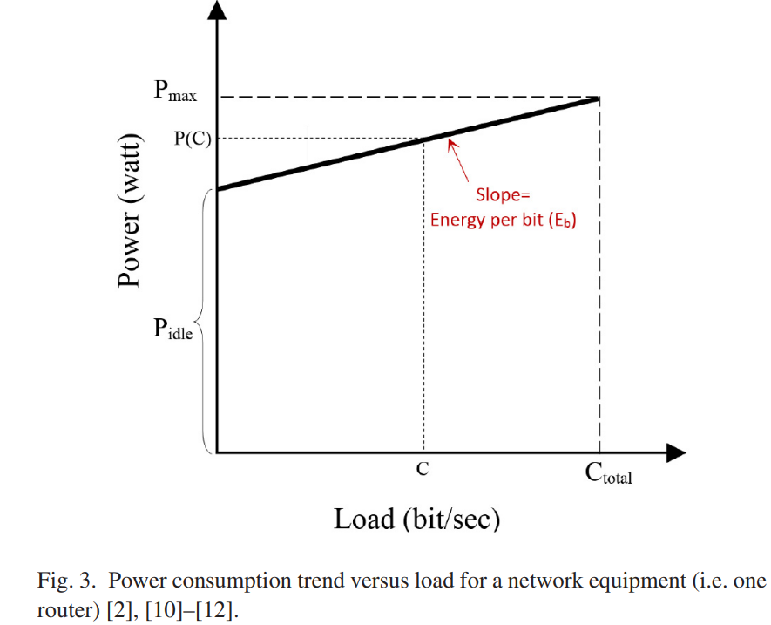


Flow-based for Shared equipment energy model

Slide 3
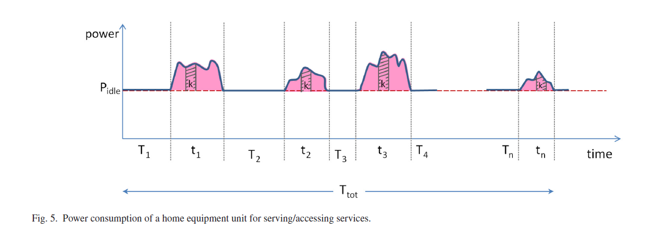

Flow-based for End users equipment energy model(time-based model)

Slide 4
Time-based model problem
2msec
2msec
Total active time= 2+2+1=5
UpLink
1.Two services transferring on one link:
5msec
Fog
Device
2msec
2.Two services transferring on both links:
Total active time= 2+2+3 != 5
DownLink
2msec
5msec

Slide 5

Time-based model problem
Reason: Time Sharing approach assumption
Solution: Considering NIC Active time

Slide 6
Time-based model problem
2msec
2msec
NIC active time= 2+2=4
Pidle*2/4 for each service
1.Two services transferring on one link:
Fog
Device
5msec
2msec
Pidle*2/2 for each service which means additional Pidle!
2.Two services transferring on both links:
NIC active time= 2
2msec
5msec

Slide 7
Solution
$CPE−Devices:E−Time−based (service k)$=
E_Active(Service k)+ TotalTime*IdlePower*(Active time of service k/NIC active time)*BW_k/ActiveBW

Slide 8
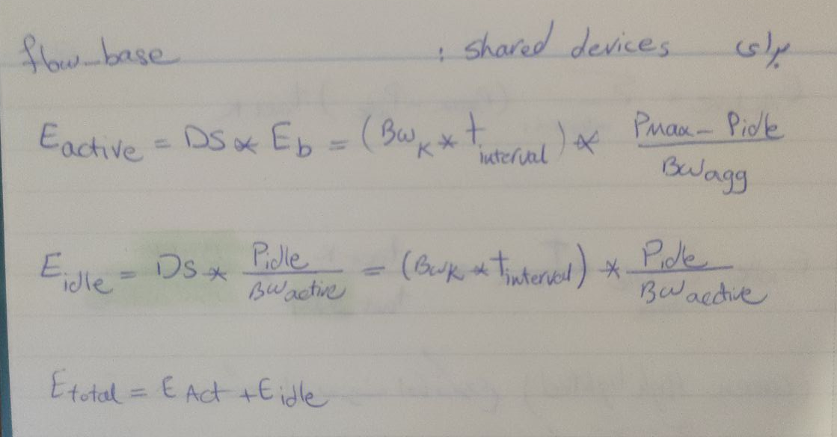
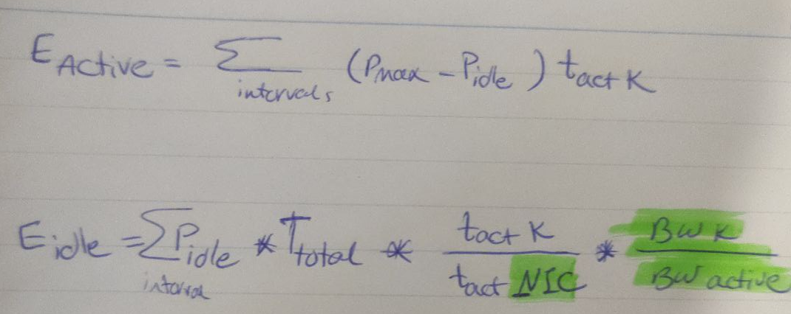
For Shared Devices:
:For User Devices

Slide 9

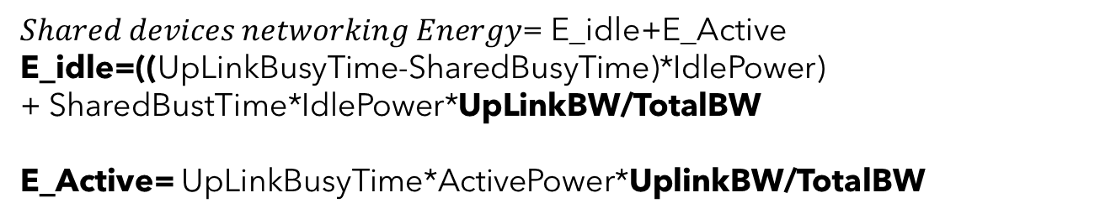
Flow-Based Energy model
cloud
Shared devices(Flow-based model)
$Shared devices networking Energy$= E_idle+E_Active
E_idle=((UpLinkBusyTime-SharedBusyTime)*IdlePower)
+ SharedBustTime*IdlePower*UpLinkBW/TotalBW
E_Active= UpLinkBusyTime*ActivePower*UplinkBW/TotalBW
Proxy
server
router
$CPE−Devices:E−Time−based (service k)$=
E_Active(Service k)+ TotalTime*IdlePower*(Active time of service k/Total active time)
End user devices (Time based model)
Smart camera
Smart camera
Smart camera
Smart camera

